Slide 1
Migrating and Grafting Routers to Accommodate Change
Eric Keller
Princeton University
Jennifer Rexford, Jacobus van der Merwe, Yi Wang, and Brian Biskeborn

Slide 2
Abstract
The complexity of network management is widely recognized as one of the biggest challenges facing the Internet today. Network operators are under tremendous pressure to make their networks highly reliable to avoid service disruptions. Yet, operators often need to change the network to upgrade faulty equipment, deploy new services, and install new routers. Unfortunately, changes cause disruptions, forcing a trade-off between the benefit of the change and the disruption it will cause. We argue that many network-management problems stem from the same root causes - the need to maintain consistency between the physical and logical configuration of the routers and the static coupling of router state and functionality to specific router instances. Hence, we propose two new network-management primitives where (i) (virtual) routers are allowed to freely move from one physical router to another, and (ii) parts of a router can be seamlessly removed from one router and merged into another without any disruption. In addition to simplifying existing network-management tasks like planned maintenance and service deployment, these primitives can also help tackle emerging challenges such as reducing energy consumption and can even be applied to traffic management. In this talk I will present the design and implementation of our modified router to incorporate these two primitives.

Slide 3
Dealing with Change
Networks need to be highly reliable
  To avoid service disruptions
Operators need to deal with change
  Install, maintain, upgrade, or decommission equipment
  Deploy new services
But… change causes disruption
  Forcing a tradeoff
Migration and Grafting
  Enabling operators to make changes
  With no (minimal) disruption

Slide 4
Shutting Down a Router (today)
How a route is propagated
128.0.0.0/8
(A, C, D, E)
B
A
128.0.0.0/8
(C, D, E)
128.0.0.0/8 (E)
128.0.0.0/8 (D, E)
128.0.0.0/8
(F, G, D, E)
E
C
D
F
G

Slide 5
Shutting Down a Router (today)
Neighbors detect router down
Choose new best route (if available)
Send out updates
Downtime best case – settle on new path (seconds)
Downtime worst case – wait for router to be up (minutes)
Both cases: lots of updates propagated
128.0.0.0/8
(A, F, G, D, E)
B
A
E
C
D
F
G

Slide 6
Moving a Link (today)
Reconfigure D, E
Remove Link
B
A
E
C
D
F
G

Slide 7
Moving a Link (today)
No route to E
B
A
withdraw
E
C
D
F
G

Slide 8
Moving a Link (today)
Downtime best case – settle on new path (seconds)
Downtime worst case – wait for link to be up (minutes)
Both cases: lots of updates propagated
B
A
128.0.0.0/8 (E)
E
C
D
128.0.0.0/8 (G, E)
F
G
Add Link
Configure E, G

Slide 9
Tradeoff
Benefit of the change
  Vs
Amount of disruption

Slide 10
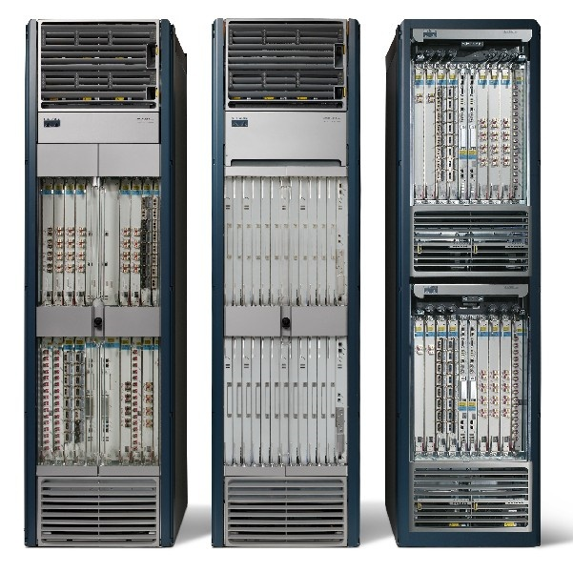
Planned Maintenance
Shut down router to…
* Replace power supply
* Upgrade to new model
Unavoidable: So operators will do it

Slide 11
Power Savings
Shut down router to…
* Save power during times of lower traffic
Not done today because of the disruption

Slide 12
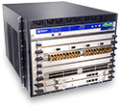

Customer Requests a Feature
Network has mixture of routers from different vendors
* Rehome customer to router with needed feature
Unavoidable (customer requested): So operators will do it

Slide 13
Traffic Management
Typical traffic engineering:
* adjust routing protocol parameters based on traffic
Congested link

Slide 14
Traffic Management
Instead…
* Rehome customer to change traffic matrix
Not done today because of the disruption

Slide 15
Why is Change so Hard?
Root cause is the monolithic view of a router
(Hardware, software, and links as one entity)
  Revisit the design to make dealing with change easier
Goals:
Routing and forwarding should not be disrupted
  Data packets are not dropped
  Routing protocol adjacencies do not go down
  All route announcements are received
Change should be transparent
  Neighboring routers/operators should not be involved
  Redesign the routers not the protocols

Slide 16
Network Management Primitives
Virtual router migration
  To break the routing software free from the physical device it is running on
Router grafting
  To break the links/sessions free from the routing software instance currently handling it

Slide 17
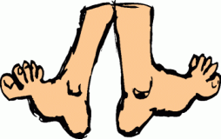
VROOM: Virtual Routers on the Move
[SIGCOMM 2008]

Slide 18
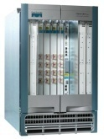
The Two Notions of “Router”
The IP-layer logical functionality, and the physical equipment
Logical
(IP layer)
Physical

Slide 19
The Tight Coupling of Physical & Logical
Root of many network-management challenges
(and “point solutions”)
Logical
(IP layer)
Physical

Slide 20
VROOM: Breaking the Coupling
Re-mapping the logical node to another physical node
VROOM enables this re-mapping of logical to physical through virtual router migration.
Logical
(IP layer)
Physical

Slide 21
Enabling Technology: Virtualization
Routers becoming virtual
data plane
control plane
Switching
Fabric

Slide 22
Case 1: Planned Maintenance
NO reconfiguration of VRs, NO reconvergence
VR-1
A
B

Slide 23
Case 1: Planned Maintenance
NO reconfiguration of VRs, NO reconvergence
A
VR-1
B

Slide 24
Case 1: Planned Maintenance
NO reconfiguration of VRs, NO reconvergence
A
VR-1
B

Slide 25
Case 2: Power Savings
$ Hundreds of millions/year of electricity bills

Slide 26
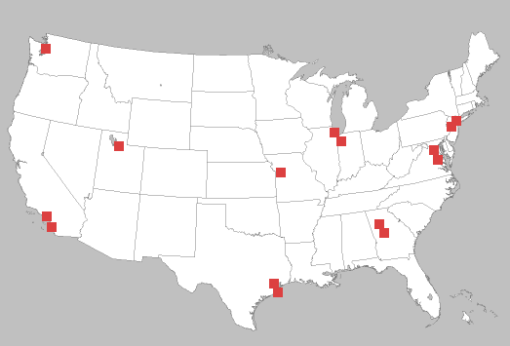


Case 2: Power Savings
Contract and expand the physical network according to the traffic volume

Slide 27
Case 2: Power Savings
Contract and expand the physical network according to the traffic volume

Slide 28
Case 2: Power Savings
Contract and expand the physical network according to the traffic volume

Slide 29
Virtual Router Migration: the Challenges
Migrate an entire virtual router instance
  All control plane & data plane processes / states
data plane
control plane
Switching
Fabric

Slide 30
Virtual Router Migration: the Challenges
Migrate an entire virtual router instance
Minimize disruption
  Data plane: millions of packets/second on a 10Gbps link
  Control plane: less strict (with routing message retransmission)

Slide 31
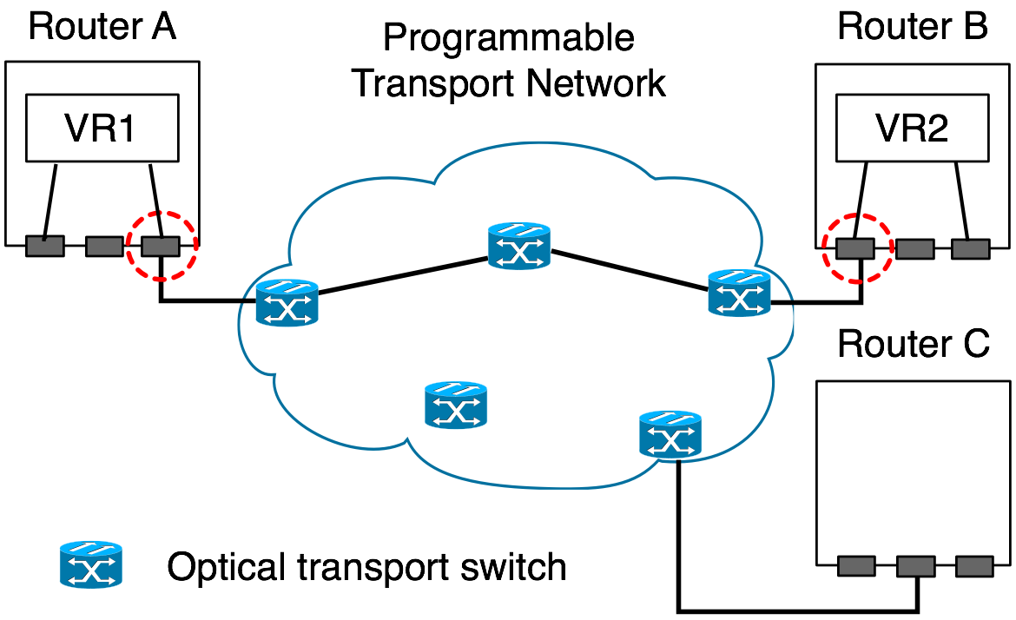
Virtual Router Migration: the Challenges
Migrate an entire virtual router instance
Minimize disruption
Link migration

Slide 32
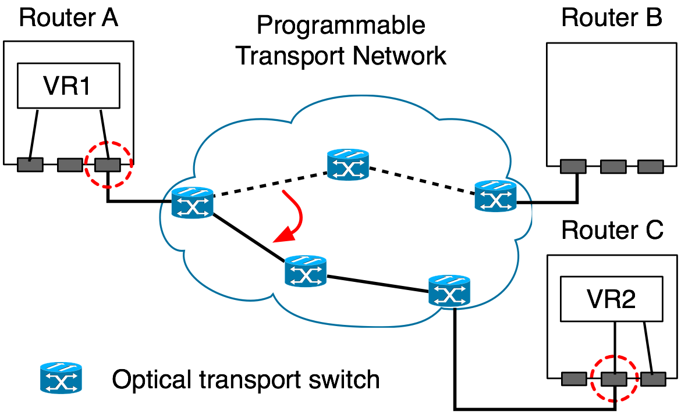
Virtual Router Migration: the Challenges
Migrate an entire virtual router instance
Minimize disruption
Link migration

Slide 33
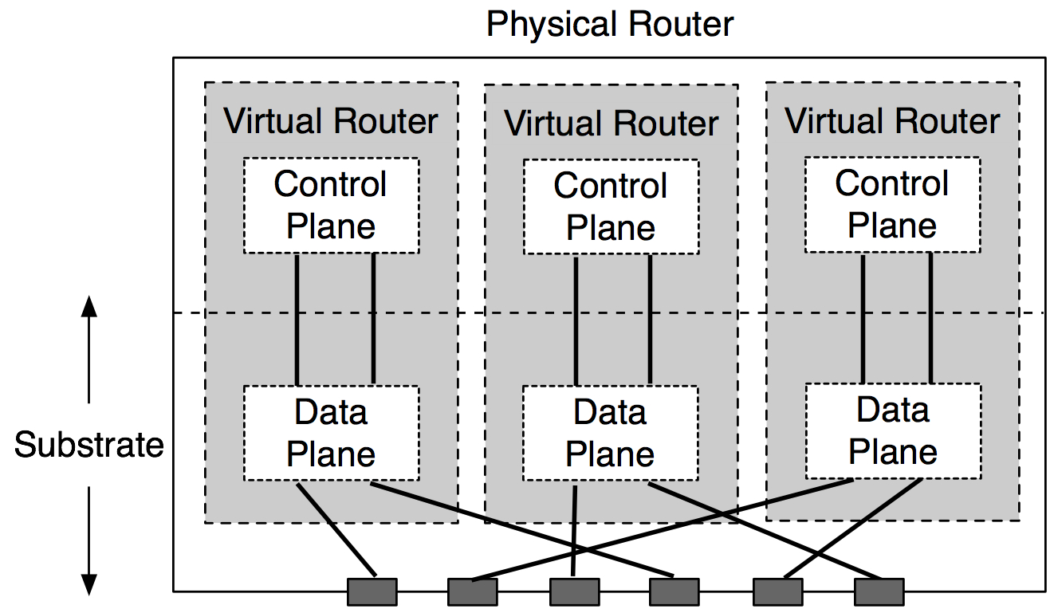
VROOM Architecture
Data-Plane Hypervisor
Dynamic Interface Binding

Slide 34
VROOM’s Migration Process
Key idea: separate the migration of control and data planes
Migrate the control plane
Clone the data plane
Migrate the links

Slide 35
Control-Plane Migration
Leverage virtual server migration techniques
Router image
  Binaries, configuration files, running processes, etc.

Slide 36
Control-Plane Migration
Leverage virtual server migration techniques
Router image
  Binaries, configuration files, running processes, etc.
CP
Physical router A
DP
Physical router B

Slide 37
Data-Plane Cloning
Clone the data plane by repopulation
  Enables traffic to be forwarded during migration
  Enables migration across different data planes
Physical router A
DP-old
CP
Physical router B
DP-new
DP-new

Slide 38
Remote Control Plane
Data-plane cloning takes time
  Installing 250k routes takes over 20 seconds*
The control & old data planes need to be kept “online”
Solution: redirect routing messages through tunnels
Physical router A
DP-old
CP
Physical router B
DP-new
*: P. Francios, et. al., Achieving sub-second IGP convergence in large IP networks,
ACM SIGCOMM CCR, no. 3, 2005.

Slide 39
Remote Control Plane
Data-plane cloning takes time
  Installing 250k routes takes over 20 seconds*
The control & old data planes need to be kept “online”
Solution: redirect routing messages through tunnels
Physical router A
DP-old
CP
Physical router B
DP-new
*: P. Francios, et. al., Achieving sub-second IGP convergence in large IP networks,
ACM SIGCOMM CCR, no. 3, 2005.

Slide 40
Double Data Planes
At the end of data-plane cloning, both data planes are ready to forward traffic
DP-old
CP
DP-new

Slide 41
Asynchronous Link Migration
With the double data planes, links can be migrated independently
A
DP-old
B
CP
DP-new

Slide 42
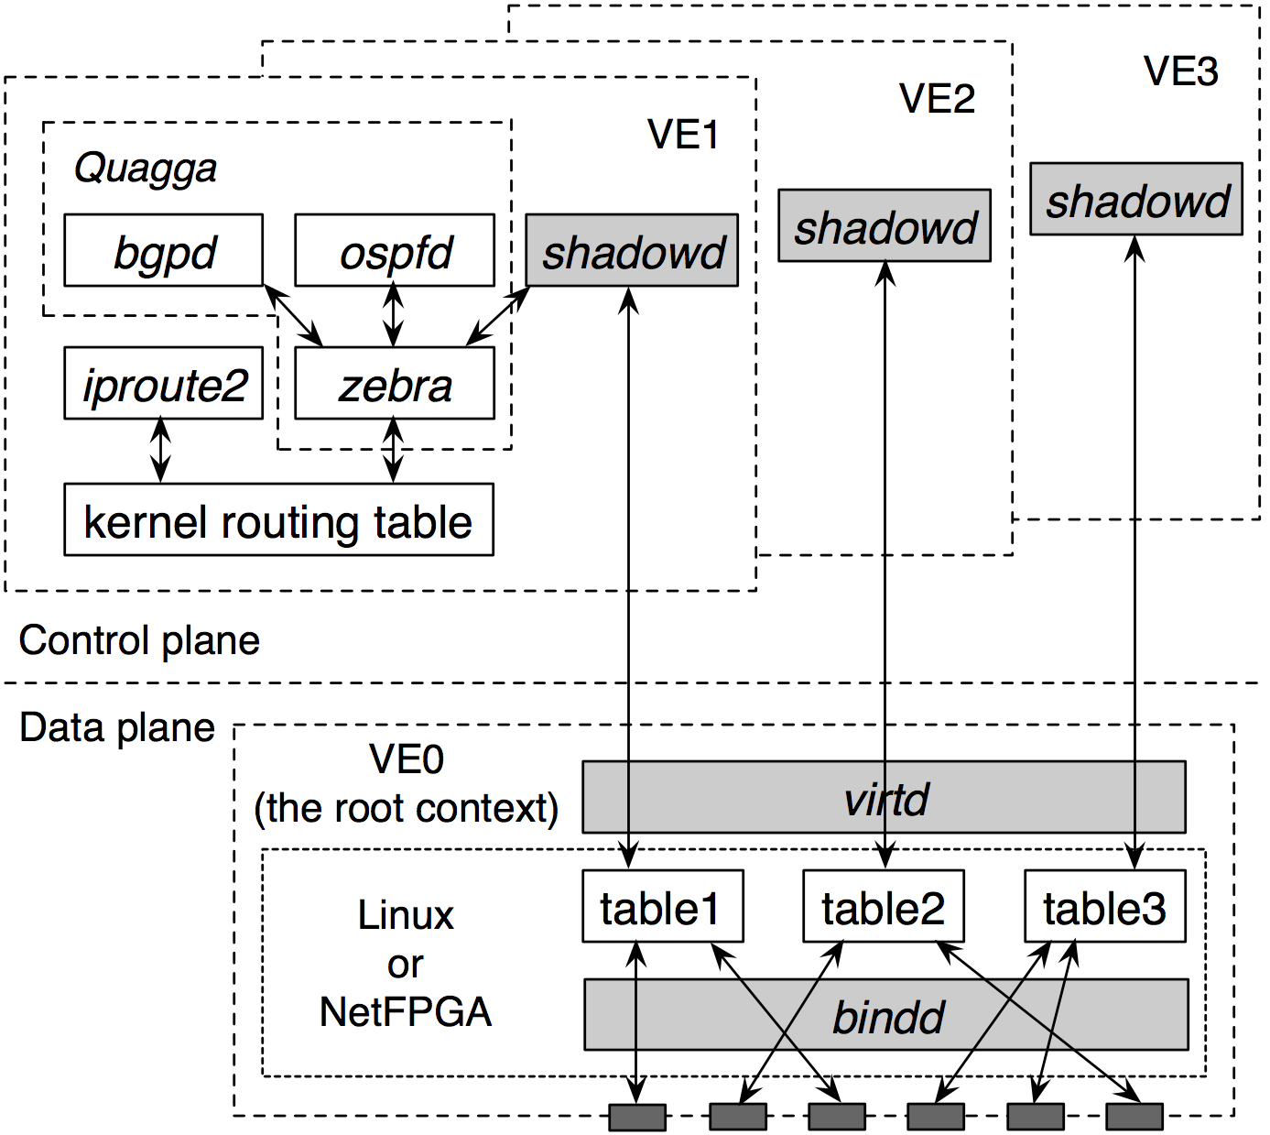
Prototype: Quagga + OpenVZ
Old router
New router
42
Notes:
42

Slide 43
Evaluation
Performance of individual migration steps
Impact on data traffic
Impact on routing protocols
Experiments on Emulab

Slide 44
Evaluation
Performance of individual migration steps
Impact on data traffic
Impact on routing protocols
Experiments on Emulab

Slide 45
Impact on Data Traffic
The diamond testbed
n1
VR
n0
n3
n2
No delay increase or packet loss

Slide 46
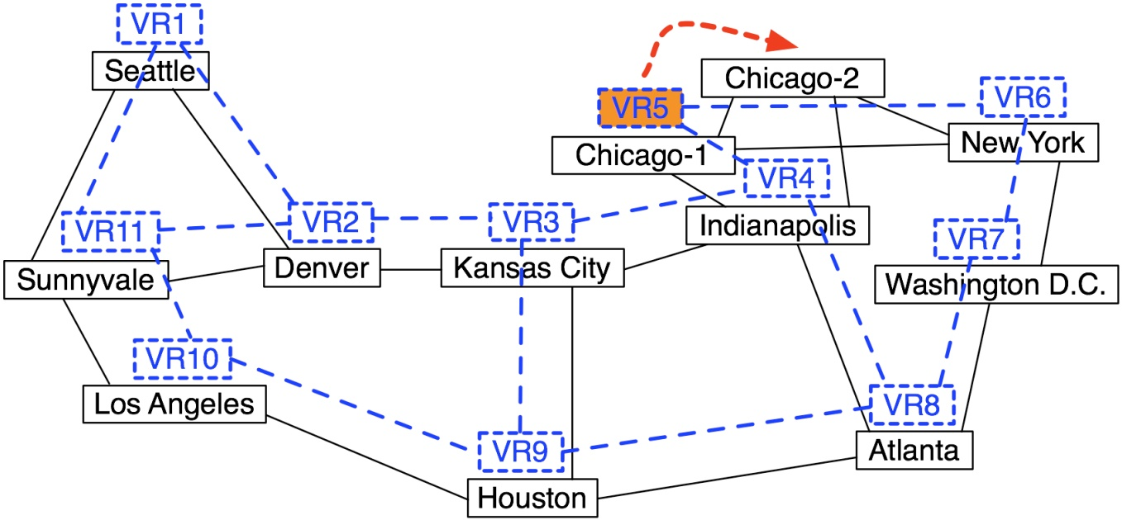
Impact on Routing Protocols
The Abilene-topology testbed

Slide 47
Edge Router Migration: OSPF + BGP
Average control-plane downtime: 3.56 seconds
OSPF and BGP adjacencies stay up
At most 1 missed advertisement retransmitted
Default timer values
  OSPF hello interval: 10 seconds
  OSPF RouterDeadInterval: 4x hello interval
  OSPF retransmission interval: 5 seconds
  BGP keep-alive interval: 60 seconds
  BGP hold time interval: 3x keep-alive interval

Slide 48
VROOM Summary
Simple abstraction
No modifications to router software
(other than virtualization)
No impact on data traffic
No visible impact on routing protocols

Slide 49
Router Grafting
[NSDI 2010]

Slide 50
Recall: Moving a single session (today)
Reconfigure old router, remove old link
Add new link link, configure new router
Establish new BGP session (exchange routes)
Downtime (minutes)
BGP updates
Logical
(IP layer)
Physical
delete peer 1.2.3.4
Add peer 1.2.3.4

Slide 51
Router Grafting: Breaking up the router
Send state
Router Grafting enables this breaking apart a router (splitting/merging).
Move link
Logical
(IP layer)
Physical

Slide 52
Grafting needs Router Modification
Goals…
  In addition to being transparent and no disruption
Minimal code changes
  Increase likelihood of adoption by vendors
Interoperability (vendors, models, versions)
  Increase usefulness
  Means we can’t do memory copying
  (need export format independent of implementation)

Slide 53
Challenge: Protocol Layers
Configure
neighbor(…)
Configure
neighbor(…)
BGP
Exchange Routes
BGP
TCP
Reliable Stream
TCP
IP
Send Packets
IP
Physical Link

Slide 54
Link and IP
Configure
neighbor(…)
Configure
neighbor(…)
BGP
Exchange Routes
BGP
TCP
Reliable Stream
TCP
IP
Send Packets
IP
Physical Link

Slide 55
Link and IP
Links use Programmable Transport Network
IP Address has local meaning only
  Moves with session
IP
IP

Slide 56
TCP
Configure
neighbor(…)
Configure
neighbor(…)
BGP
Exchange Routes
BGP
TCP
Reliable Stream
TCP
IP
Send Packets
IP
Physical Link

Slide 57
TCP
Keeping it completely transparent
  Sequence numbers
  Packet input queue (packets that were not read)
  Packet output queue (packets that were not ack’d yet)
app
recv()
send()
TCP(data, seq, …)
ack
OS
TCP(data’, seq’)

Slide 58
BGP
Configure
neighbor(…)
Configure
neighbor(…)
BGP
Exchange Routes
BGP
TCP
Reliable Stream
TCP
IP
Send Packets
IP
Physical Link

Slide 59
BGP: Not just state transfer
Migrate session
AS300
AS100
AS200
AS400

Slide 60
BGP: Not just state transfer
Migrate session
AS300
AS100
AS200
AS400
Need to re-run decision processes
Notes:
Routers inside of network need to be told of change (to reach points to the left)
Routers outside of the network (on the left) need to be told of the change as the AS path changed

Slide 61
BGP: What (not) to Migrate
Requirements
  Want data packets to be delivered
  Want routing adjacencies to remain up
Need
  Configuration
  Routing information
Do not need
  State machine
  Statistics
  Timers

Slide 62
BGP: Configuration
Router sessions configured via command line (file)
  Policies, details about neighbor
  Stored in internal data structures
Extract relevant commands
  Apply to new router
  Translated if necessary
Need to modify software
  Start ‘inactive’ (waiting for migrate in)

Slide 63
BGP: Route Information
Routes from neighbor
  Needed so neighbor doesn’t need to re-announce
  B has different routes than A
  Need to rerun decision process
Propagate
(if best)
Stores as RIB-in
A
B

Slide 64
BGP: Route Information
Routes to neighbor
  A’s best routes sent to neighbor
  After migration, topology changes
  Need to diff what A sent with what B would have sent
Stores as RIB-out
A
B
Propagate
best
B would have
sent different route

Slide 65
BGP: Special Case - Cluster Router
* Links “migrated” internally
* Topology doesn’t change (no need to run decision process)
Blade
Blade
A
B
C
D
Line card
Switching
Fabric
Line card
Line card
Line card
A
C
B
D

Slide 66
Prototype
Added grafting into Quagga
  RIB and decision process well separated
Graft daemon to control process
SockMi for TCP migration
Migrate-from Router
Modified
Quagga
graft
daemon
click-based
link migration
Remote End-point
Router
Linux kernel
2.6.19.7
SockMi.ko
Handler
Comm
Quagga
Migrate-to Router
Linux kernel
2.6.19.7-click
click.ko
Linux kernel
2.6.19.7
Modified
Quagga
graft
daemon
Linux kernel
2.6.19.7
SockMi.ko

Slide 67
Evaluation
Impact on data traffic
Impact on routing protocols
Overhead on rest of the network

Slide 68
Evaluation
Impact on data traffic
Impact on routing protocols
Overhead on rest of the network

Slide 69
Impact on Routing Protocols
CPU utilization affected by time to complete
  Includes export, transmit, import, lookup, and decision
  6.8s for between routers
  4.4s for between blades
  Further optimizations possible
Protocols affected by unresponsiveness
  Set old router to “inactive”, migrate link, migrate TCP, set new router to “active”
  A few milliseconds

Slide 70
Overhead on rest of network
How much communication/work on other routers?
  Function of how routers are configured
  e.g., Would A and B choose same route?
  (doing analysis as ongoing work)
  Expected case: only minimal communication needed
A
B
Updates sent as a
result of migration

Slide 71
Router Grafting Summary
Enables moving a single link/session with…
  Minimal code change
  No impact on data traffic
  No visible impact on routing protocol adjacencies
  Minimal overhead on rest of network

Slide 72
Migrating and Grafting Together
Router Grafting can do everything VROOM can
  By migrating each link individually
But VROOM is more efficient when…
  Want to move all sessions
  Moving between compatible routers
  (same virtualization technology)
  Want to preserve “router” semantics
VROOM requires no code changes
  Can run a grafting router inside of virtual machine
  (e.g., VROOM + Grafting)
  Each useful for different tasks

Slide 73
Conclusion
To enable change without disruption
  Need to revisit monolithic view of a router
Decouple the software from the hardware
  VROOM
Decouple the links from the router software
  Router Grafting
Future Work: Hosted Virtual Networks
  Decouple who runs the routing software from
  who owns/maintains the routing equipment

Slide 74
Questions?
Contact info:
  ekeller@princeton.edu
  http://www.princeton.edu/~ekeller

