Slide 1

Dynamic Infrastructure for Dependable Cloud Services
Eric Keller
Princeton University

Slide 2

Cloud Computing
Services accessible across a network
Available on any device from any where
No installation or upgrade
Documents
Videos
Photos

Slide 3
What makes it cloud computing?
Dynamic infrastructure with illusion of infinite scale
  Elastic and scalable

Slide 4






What makes it cloud computing?
Dynamic infrastructure with illusion of infinite scale
  Elastic and scalable
Hosted infrastructure (public cloud)
Benefits…
  Economies of scale
  Pay for what you use
  Available on-demand (handle spikes)

Slide 5






Cloud Services
Increasingly demanding
e-mail → social media → streaming (live) video

Slide 6
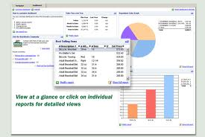
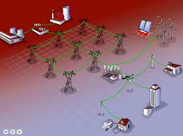
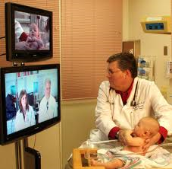
Cloud Services
Increasingly demanding
e-mail → social media → streaming (live) video
Increasingly critical
business software → smart power grid → healthcare

Slide 7
Cloud Services
Increasingly demanding
e-mail → social media → streaming (live) video
Increasingly critical
business software → smart power grid → healthcare
Available
Secure
High performance
Dependable

Slide 8
“In the Cloud”
Documents
Videos
Photos
8

Slide 9

“In the Cloud”
But it’s a real infrastructure with real problems
Not controlled by the user
Not even controlled by the service provider
9

Slide 10
Today’s Network Infrastructure

Slide 11
Today’s Network Infrastructure
Network operators need to make changes
  Install, maintain, upgrade equipment
  Manage resource (e.g., bandwidth)

Slide 12

Today’s (Brittle) Network Infrastructure
Network operators need to deal with change
  Install, maintain, upgrade equipment
  Manage resource (e.g., bandwidth)

Slide 13
Today’s (Buggy) Network Infrastructure
Single update partially brought down Internet
  8/27/10: House of Cards
  5/3/09: AfNOG Takes Byte Out of Internet
  2/16/09: Reckless Driving on the Internet
[Renesys]

Slide 14

Today’s (Buggy) Network Infrastructure
Single update partially brought down Internet
  8/27/10: House of Cards
  5/3/09: AfNOG Takes Byte Out of Internet
  2/16/09: Reckless Driving on the Internet
[Renesys]
How to build a Cybernuke

Slide 15
Today’s Computing Infrastructure
Virtualization used to share servers
  Software layer running under each virtual machine
Guest VM1
Guest VM2
Apps
Apps
OS
OS
Hypervisor
Physical Hardware

Slide 16
Today’s (Vulnerable) Computing Infrastructure
Virtualization used to share servers
  Software layer running under each virtual machine
Malicious software can run on the same server
  Attack hypervisor
  Access/Obstruct other VMs
Guest VM1
Guest VM2
Apps
Apps
OS
OS
Hypervisor
Physical Hardware

Slide 17
Dependable Cloud Services?
Vulnerable computing
infrastructure
Brittle/Buggy network
infrastructure

Slide 18
Interdisciplinary Systems Research
Across computing and networking

Slide 19
Interdisciplinary Systems Research
Across computing and networking
Across layers within computing/network node
Rethink layers
Apps
Apps
Distributed Systems /
Routing software
OS
OS
Operating system /
network stack
Virtualization
Physical Hardware
Computer Architecture

Slide 20
Dynamic Infrastructure for
Dependable Cloud Services
Part I: Make network infrastructure dynamic
  Rethink the monolithic view of a router
  Enabling network operators to accommodate change
Part II: Address security threat in shared computing
  Rethink the virtualization layer in computing infrastructure
  Eliminating security threat unique to cloud computing

Slide 21
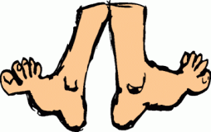
Part I
Migrating and Grafting Routers
to Accommodate Change
[SIGCOMM 2008] [NSDI 2010]

Slide 22
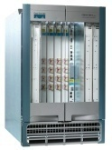
The Two Notions of “Router”
The IP-layer logical functionality, and the physical equipment
Logical
(IP layer)
Physical

Slide 23
The Tight Coupling of Physical & Logical
Root cause of disruption is monolithic view of router
(hardware, software, links as one entity)
Logical
(IP layer)
Physical

Slide 24
The Tight Coupling of Physical & Logical
Root cause of disruption is monolithic view of router
(hardware, software, links as one entity)
Logical
(IP layer)
Physical

Slide 25
Breaking the Tight Couplings
Root cause of disruption is monolithic view of router
(hardware, software, links as one entity)
    Decouple logical from physical
      Allowing nodes to move around
    Decouple links from nodes
      Allowing links to move around
Logical
(IP layer)
Physical

Slide 26
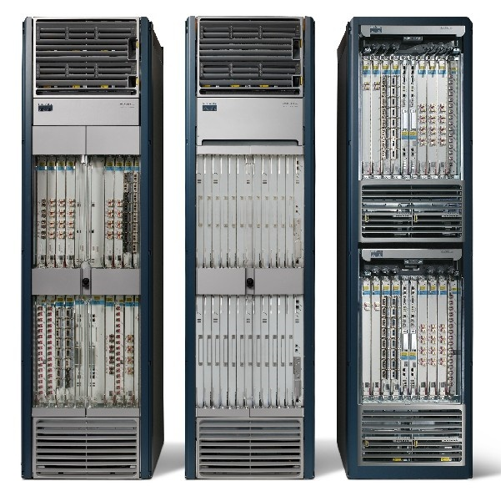
Planned Maintenance
Shut down router to…
  Replace power supply
  Upgrade to new model
  Contract network
Add router to…
  Expand network

Slide 27
Planned Maintenance
Migrate logical router to another physical router
VR-1
A
B

Slide 28
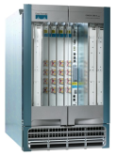
Planned Maintenance
Perform maintenance
A
VR-1
B

Slide 29
Planned Maintenance
Migrate logical router back
NO reconfiguration, NO reconvergence
A
VR-1
B

Slide 30
Planned Maintenance
Could migrate external links to other routers
  Away from router being shutdown, or
  To router being added (or brought back up)
OSPF or Fast re-route for internal links

Slide 31
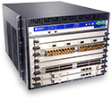

Customer Requests a Feature
Network has mixture of routers from different vendors
* Rehome customer to router with needed feature

Slide 32
Traffic Management
Typical traffic engineering:
* adjust routing protocol parameters based on traffic
Congested link

Slide 33
Traffic Management
Instead…
* Rehome customer to change traffic matrix

Slide 34
Migrating and Grafting
Virtual Router Migration (VROOM)
[SIGCOMM 2008]
  Allow (virtual) routers to move around
  To break the routing software free from the physical device it is running on
  Built prototype with OpenVZ, Quagga, NetFPGA or Linux
Router Grafting [NSDI 2010]
  To break the links/sessions free from the routing software instance currently handling it

Slide 35
Router Grafting: Breaking up the router
Send state
Move link

Slide 36
Router Grafting: Breaking up the router
Router Grafting enables this breaking apart a router (splitting/merging).

Slide 37
Not Just State Transfer
Migrate session
AS300
AS100
AS200
AS400

Slide 38
Not Just State Transfer
Migrate session
AS300
AS100
The topology changes
(Need to re-run decision processes)
AS200
AS400

Slide 39
Goals
Routing and forwarding should not be disrupted
  Data packets are not dropped
  Routing protocol adjacencies do not go down
  All route announcements are received
Change should be transparent
  Neighboring routers/operators should not be involved
  Redesign the routers not the protocols

Slide 40
Challenge: Protocol Layers
A
B
BGP
Exchange routes
BGP
TCP
Deliver reliable stream
TCP
IP
Send packets
IP
Physical Link
Migrate
State
C
Migrate
Link

Slide 41
Physical Link
A
B
BGP
Exchange routes
BGP
TCP
Deliver reliable stream
TCP
IP
Send packets
IP
Physical Link
Migrate
State
C
Migrate
Link

Slide 42
Physical Link
Unplugging cable would be disruptive
Move
Link
neighboring network
network making change

Slide 43
Physical Link
Unplugging cable would be disruptive
Links are not physical wires
  Switchover in nanoseconds
Optical Switches
mi
Move
Link
neighboring network
network making change

Slide 44
IP
A
B
BGP
Exchange routes
BGP
TCP
Deliver reliable stream
TCP
IP
Send packets
IP
Physical Link
Migrate
State
C
Migrate
Link

Slide 45
Changing IP Address
IP address is an identifier in BGP
Changing it would require neighbor to reconfigure
  Not transparent
  Also has impact on TCP (later)
mi
1.1.1.2
1.1.1.1
Move
Link
neighboring network
network making change

Slide 46
Re-assign IP Address
IP address not used for global reachability
  Can move with BGP session
  Neighbor doesn’t have to reconfigure
mi
1.1.1.1
Move
Link
1.1.1.2
neighboring network
network making change

Slide 47
TCP
A
B
BGP
Exchange routes
BGP
TCP
Deliver reliable stream
TCP
IP
Send packets
IP
Physical Link
Migrate
State
C
Migrate
Link

Slide 48
Dealing with TCP
TCP sessions are long running in BGP
  Killing it implicitly signals the router is down
BGP and TCP extensions as a workaround
(not supported on all routers)

Slide 49
Migrating TCP Transparently
Capitalize on IP address not changing
  To keep it completely transparent
Transfer the TCP session state
  Sequence numbers
  Packet input/output queue (packets not read/ack’d)
app
recv()
send()
TCP(data, seq, …)
ack
OS
TCP(data’, seq’)

Slide 50
BGP
A
B
BGP
Exchange routes
BGP
TCP
Deliver reliable stream
TCP
IP
Send packets
IP
Physical Link
Migrate
State
C
Migrate
Link

Slide 51
BGP: What (not) to Migrate
Requirements
  Want data packets to be delivered
  Want routing adjacencies to remain up
Need
  Configuration
  Routing information
Do not need (but can have)
  State machine
  Statistics
  Timers
Keeps code modifications to a minimum

Slide 52
Routing Information
Could involve remote end-point
  Similar exchange as with a new BGP session
  Migrate-to router sends entire state to remote end-point
  Ask remote-end point to re-send all routes it advertised
Disruptive
  Makes remote end-point do significant work
mi
mi
Move
Link
Exchange Routes

Slide 53
Routing Information (optimization)
Migrate-from router send the migrate-to router:
The routes it learned
  Instead of making remote end-point re-announce
The routes it advertised
  So able to send just an incremental update
mi
mi
Send routes
advertised/learned
Move
Link
Incremental
Update

Slide 54
Migration in The Background
Migration takes a while
  A lot of routing state to transfer
  A lot of processing is needed
Routing changes can happen at any time
Migrate in the background
mi
mi
Move
Link

Slide 55
Prototype
Added grafting into Quagga
  Import/export routes, new ‘inactive’ state
  Routing data and decision process well separated
Graft daemon to control process
SockMi for TCP migration
Graftable Router
Emulated
link migration
Unmod.
Router
Modified
Quagga
graft
daemon
Handler
Comm
Quagga
SockMi.ko
click.ko
Linux kernel 2.6.19.7
Linux kernel 2.6.19.7-click
Linux kernel 2.6.19.7

Slide 56
Evaluation
Mechanism:
Impact on migrating routers
Disruption to network operation
Application:
Traffic engineering

Slide 57
Impact on Migrating Routers
How long migration takes
  Includes export, transmit, import, lookup, decision
  CPU Utilization roughly 25%
Between Routers
0.9s (20k)
6.9s (200k)

Slide 58
Disruption to Network Operation
Data traffic affected by not having a link
  nanoseconds
Routing protocols affected by unresponsiveness
  Set old router to “inactive”, migrate link, migrate TCP, set new router to “active”
  milliseconds

Slide 59
Traffic Engineering Evaluation
Internet2 topology, and traffic data
Developed algorithms to determine links to graft

Slide 60
Traffic Engineering Evaluation
Internet2 topology, and traffic data
Developed algorithms to determine links to graft
Network can handle more traffic
(at same level of congestion)

Slide 61
Router Grafting Conclusions
Enables moving a single link with…
  Minimal code change
  No impact on data traffic
  No visible impact on routing protocol adjacencies
  Minimal overhead on rest of network
Applying to traffic engineering…
  Enables changing ingress/egress points
  Networks can handle more traffic

Slide 62
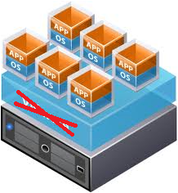
Part II
Virtualized Cloud Infrastructure
without the Virtualization
[ISCA 2010]

Slide 63
Today’s (Vulnerable) Computing Infrastructure
Virtualization used to share servers
  Software layer running under each virtual machine
Malicious software can run on the same server
  Attack hypervisor
  Access/Obstruct other VMs
Guest VM1
Guest VM2
Apps
Apps
OS
OS
Hypervisor
Physical Hardware

Slide 64
Is this Problem Real?
No headlines… doesn’t mean it’s not real
  Not enticing enough to hackers yet?
  (small market size, lack of confidential data)
Virtualization layer huge and growing
Derived from existing operating systems
  Which have security holes

Slide 65
NoHype
NoHype removes the hypervisor
  There’s nothing to attack
  Complete systems solution
  Still retains the needs of a virtualized cloud infrastructure
Guest VM1
Guest VM2
Apps
Apps
OS
OS
No hypervisor
Physical Hardware

Slide 66
Virtualization in the Cloud
Why does a cloud infrastructure use virtualization?
  To support dynamically starting/stopping VMs
  To allow servers to be shared (multi-tenancy)
Do not need full power of modern hypervisors
  Emulating diverse (potentially older) hardware
  Maximizing server consolidation

Slide 67
Roles of the Hypervisor
Isolating/Emulating resources
  CPU: Scheduling virtual machines
  Memory: Managing memory
  I/O: Emulating I/O devices
Networking
Managing virtual machines
Push to HW /
Pre-allocation
Remove
Push to side

Slide 68
Scheduling Virtual Machines
Today
Scheduler called each time hypervisor runs
(periodically, I/O events, etc.)
  Chooses what to run next on given core
  Balances load across cores
VMs
timer
switch
I/O
switch
timer
switch
hypervisor
time

Slide 69
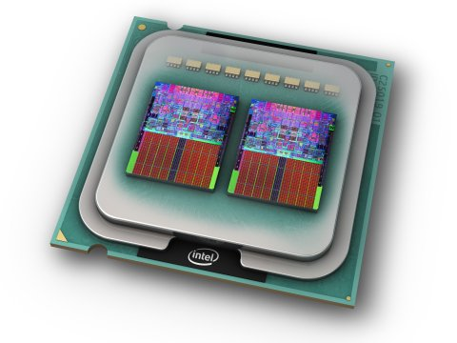
Dedicate a core to a single VM
NoHype
Ride the multi-core trend
  1 core on 128-core device is ~0.8% of the processor
Cloud computing is pay-per-use
  During high demand, spawn more VMs
  During low demand, kill some VMs
  Customer maximizing each VMs work,
  which minimizes opportunity for over-subscription

Slide 70
Managing Memory
Today
Goal: system-wide optimal usage
  i.e., maximize server consolidation
Hypervisor controls allocation of physical memory

Slide 71
Pre-allocate Memory
NoHype
In cloud computing: charged per unit
  e.g., VM with 2GB memory
Pre-allocate a fixed amount of memory
  Memory is fixed and guaranteed
  Guest VM manages its own physical memory
  (deciding what pages to swap to disk)
Processor support for enforcing:
  allocation and bus utilization

Slide 72

Emulate I/O Devices
Today
Guest sees virtual devices
  Access to a device’s memory range traps to hypervisor
  Hypervisor handles interrupts
  Privileged VM emulates devices and performs I/O
Priv. VM
Guest VM1
Guest VM2
Device
Emulation
Apps
Apps
Real
Drivers
OS
OS
hypercall
trap
trap
Hypervisor
Physical Hardware

Slide 73
Emulate I/O Devices
Today
Guest sees virtual devices
  Access to a device’s memory range traps to hypervisor
  Hypervisor handles interrupts
  Privileged VM emulates devices and performs I/O
Priv. VM
Guest VM1
Guest VM2
Device
Emulation
Apps
Apps
Real
Drivers
OS
OS
hypercall
trap
trap
Hypervisor
Physical Hardware

Slide 74
Dedicate Devices to a VM
NoHype
In cloud computing, only networking and storage
Static memory partitioning for enforcing access
  Processor (for to device), IOMMU (for from device)
Guest VM1
Guest VM2
Apps
Apps
OS
OS
Physical Hardware

Slide 75
Virtualize the Devices
NoHype
Per-VM physical device doesn’t scale
Multiple queues on device
  Multiple memory ranges mapping to different queues
Network Card
Classify
MAC/PHY
Processor
Chipset
Peripheral
bus
MUX
Memory

Slide 76


Networking
Today
Ethernet switches connect servers
server
server

Slide 77
Networking (in virtualized server)
Today
Software Ethernet switches connect VMs
Virtual server
Virtual server
Software
Virtual switch

Slide 78
Networking (in virtualized server)
Today
Software Ethernet switches connect VMs
Guest VM1
Guest VM2
Apps
Apps
OS
OS
Hypervisor
hypervisor

Slide 79
Networking (in virtualized server)
Today
Software Ethernet switches connect VMs
Priv. VM
Guest VM1
Guest VM2
Software
Switch
Apps
Apps
OS
OS
Hypervisor

Slide 80
Do Networking in the Network
NoHype
Co-located VMs communicate through software
  Performance penalty for not co-located VMs
  Special case in cloud computing
  Artifact of going through hypervisor anyway
Instead: utilize hardware switches in the network
  Modification to support hairpin turnaround

Slide 81
Removing the Hypervisor Summary
Scheduling virtual machines
  One VM per core
Managing memory
  Pre-allocate memory with processor support
Emulating I/O devices
  Direct access to virtualized devices
Networking
  Utilize hardware Ethernet switches
Managing virtual machines
  Decouple the management from operation

Slide 82
NoHype Double Meaning
Means no hypervisor, also means “no hype”
Multi-core processors
Extended Page Tables
SR-IOV and Directed I/O (VT-d)
Virtual Ethernet Port Aggregator (VEPA)

Slide 83
Prototype
Xen as starting point
Pre-configure all resources
Support for legacy boot
  Use known good kernel
  (i.e., non-malicious)
  Temporary hypervisor
  Before switching to user code,
  switch off hypervisor
Priv. VM
Guest VM1
xm
kernel
Xen
Kill VM
core
core

Slide 84
Improvements for Future Technology
Main Limitations:
Inter-processor Interrupts
Side channels
Legacy boot

Slide 85
Improvements for Future Technology
Main Limitations:
Inter-processor Interrupts
Side channels
Legacy boot
Processor Architecture
(minor change)
Processor Architecture
Operating Systems in
Virtualized Environments

Slide 86
NoHype Conclusions
Significant security issue threatens cloud adoption
NoHype solves this by removing the hypervisor
Performance improvement is a side benefit

Slide 87
Brief Overview of My Other Work
Software reliability in routers
Reconfigurable computing

Slide 88
Software Reliability in Routers
Routing
Software
Routing
Software
Router
Bugs
Routing
Software
“Hypervisor”
OS
OS
CPU
CPU
Performance
Wall
Routing
Software
FPGA

Slide 89

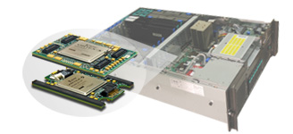
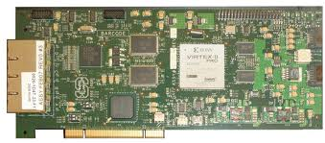
Reconfigurable Computing
FPGAs in networking
  Click + G: a domain specific design environment
Taking advantage of reconfigurability
  JBits, Self-reconfiguration
  Demonstration applications (e.g., bio-informatics, DSP)
FPGA alongside CPUs
FPGAs in network components

Slide 90
Future Work
Computing
  Securing the cloud
  Rethink server architecture in large data centers
Networking
  Hosted and shared network infrastructure
  Refactoring routers to ease management

Slide 91
“The Network is the Computer” [John Gage ‘84]
  Exciting time when this is becoming a reality

Slide 92
Questions?
Contact info:
  ekeller@princeton.edu
  http://www.princeton.edu/~ekeller

